Slide 1

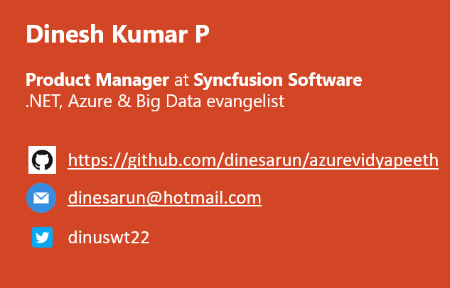
``
Is Big Data Hyped?
Different Data services..
Notes:
Good evening guys. I am Dinesh Kumar. Product Manager at Syncfusion Software. I role play as a Growth Hacker in Data Platform team. And I am pretty happy to present this session to you all.

Slide 2
Big Data Which data service to use & Why?
Notes:
“Which one to use and why?” – This is the key take away that I wish to give you all today. A good set of information about different data services available as open source and in cloud.

Slide 3
Agenda
Data Scientist
Data Analyst
ML Engineer
Data Admin
BI Engineer
Notes:
We will be having today’s session as stories that revolves around these work roles. And in current trend we need to know beyond backend because of 2 reasons,
-> “Big Data” - is not a technology or Software, its THINKING.
-> And an application is no more just serving a UI to carry out the business activities that does CRUD operations in background. It has turned far further to carry out business directly and allows us to find instant insights.

Slide 4
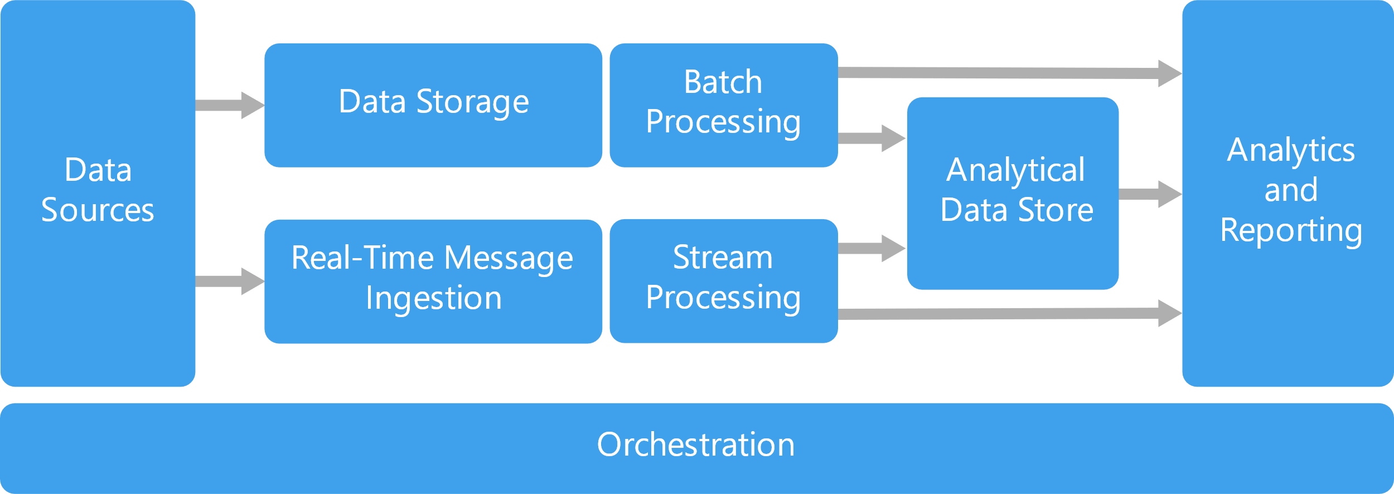
Notes:
Processes involved in a typical data project or any projects that ends with delivering something for decision making.

Slide 5
Data Engineers
Which (raw) data to use? - Almost all.
What kind of environment should I setup? – More of Data Admin.
How the data has to be processed to get clean data or insights out of it? – More of Data Developer.
Identify Combinations of prepared data and machine learning algorithms to create best model? – More of Data Scientist.
All these analysis as dashboard / report for decision making. – More of BI specialist.
Notes:
In spite we are not called as Data engineers, we will be coming across any of these questions at some point of our work.

Slide 6
What is Big Data and Why Big Data

Slide 7

Domains, Industries
Marketing
Sales and CRM
Web Analytics
Ecommerce
Advertising
IT
Finance
Healthcare
Social Media
SEO
Banking
Human Resources
Mobile Analytics
Project Management
Research and Development
Support
Survey
Insurance
Manufacturing
Energy
Oil & Gas
Pharmaceuticals
Retail
Communications
Food and Beverages
Education
Media
Transportation and Logistics
Notes:
Similarly, would be working in any 1 or more of these domains.
Different domains now a days produces different KINDS of data. Upon which all cannot be fit into traditional SQL based database systems for storage or processing or analyzing.

Slide 8
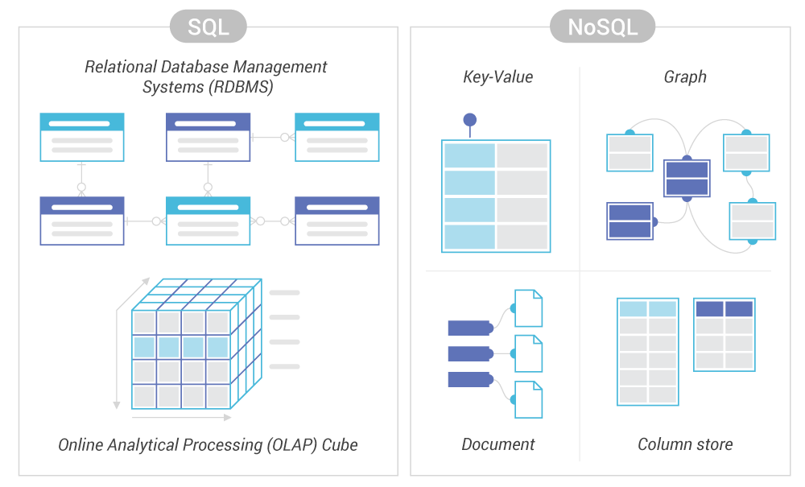
Notes:
SQL, No SQL

Slide 9
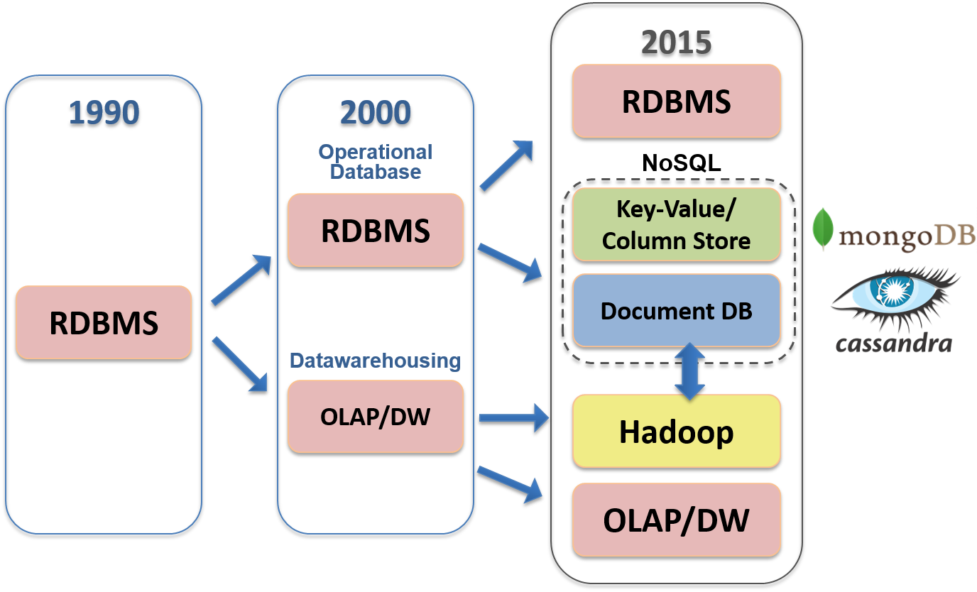
Notes:
I hope all of you would have worked in one or more of these sectors of data storage frameworks

Slide 10
What is Big Data?
Volume – Tera bytes to peta bytes.
Variety – Transactions, Web logs, social media interactions.
Velocity – Daily to real-time. Simply say, actionable insights asap.
https://aws.amazon.com/big-data/what-is-big-data/
Notes:
Big Data is all about the management challenges because of increasing volume, velocity and variety of data which cannot be solved with traditional databases.
Plenty of definitions like this. But 3 Vs will always be simple to understand.

Slide 11
Why BigData? SQL Comparison
Hadoop (Big Data storage) | SQL
Schema on Read | Schema on Write
Data stored as Compressed form as txt / csv or any form. | Stored as logical forms and inter related columns
Distributed processing across commodity hardware. | Centralized processing over high-end hardware.
Horizontal scaling | Vertical scaling

Slide 12
Why Big Data?
Open source analogy (Cost).
Enriched with rich ecosystem to be played with,
SQL, No SQL,..
Cloud, On-Premises..
Base for almost all Analytics (AI, ML) use-cases.
At the early 2012 – it’s a big fame too ☺.
Notes:
Cost reduction - Big data technologies such as Hadoop and cloud-based analytics bring significant cost advantages when it comes to storing large amounts of data.

Slide 13
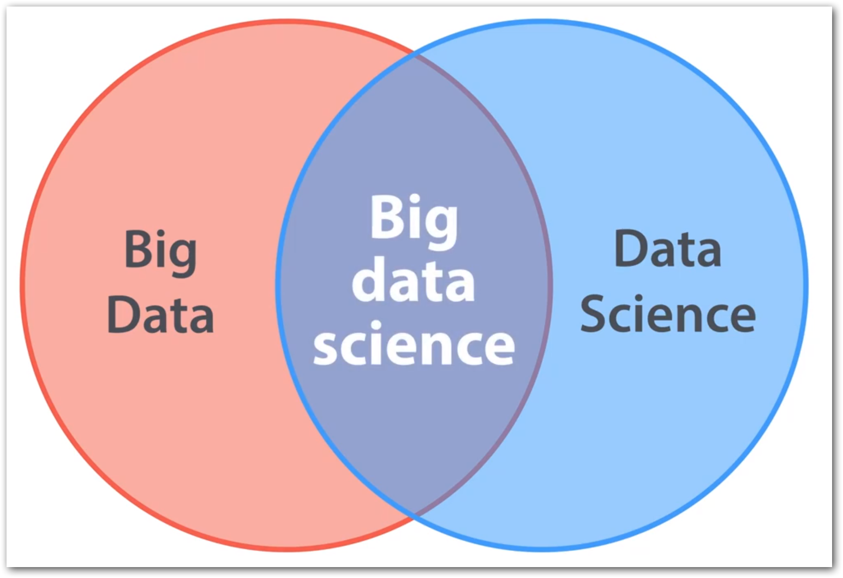
Big Data vs Data Science
Big Data + Data Science = Big Data Science.
Big Data ≠ Data Science
Big Data <- All 4 Vs;
E.g.
Shares trading, E-Shopping – Volume and/or Veracity.
ML use cases like Genetics data, Credit card fraud detection – Volume.
Notes:
Frequent confusion among us.
Data science – Combination of different tools, alg, ml principles with the goal to discover hidden patterns from raw data.
Big Data – Large amount of data in different formats, at different speed and not all the data may be used for analysis / analytics. Simply say 4 Vs which we saw earlier.

Slide 14
Big Data hype - Then…
Companies were selling Big Data solutions as a silver bullet to all the enterprises’ problems.
Use case using Hive+Oozie turned with MySQL+Cron.
There was no ideal approach like below;
Client - “I want to implement a Big Data solution”
Consultant- “That could be the solution, but let us discuss the problem first”.
Notes:
Failure – If one thing doesn’t give an expected result. Which is what faced by many who adopted Big Data too earlier or just for the hype. And that's same reason many doesn’t pitch back again to try-out at later days too.

Slide 15
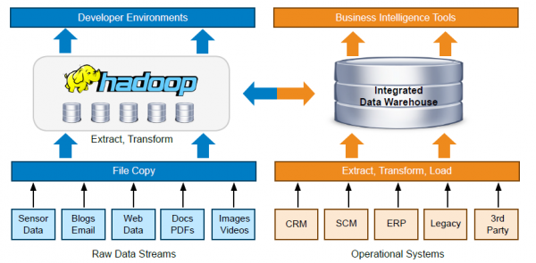
Notes:
Orchestration of the entire process. ML Ops

Slide 16
Big Data hype - Now…
Shift in requirement:
Storage and Processing(ETL) -> Analytics.
Examples:
More New products emerge around Machine Learning and Artificial Intelligence.
Cloudera and Hortonworks merged.
Still ecosystems are getting upgraded equally with Hadoop. E.g. Pig, Sqoop, Oozie,…
Notes:
Reason for the shift?
Storage and Processing work loads are now a days becoming less complex because of options we have in Cloud. Which we will explore next in detail.

Slide 17
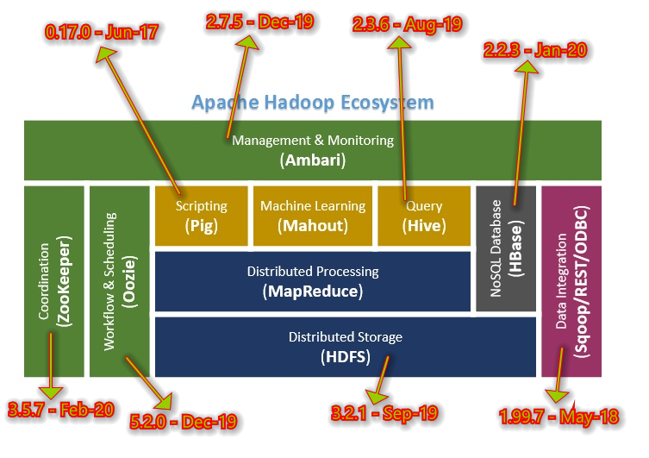
New versions release date
Notes:
Latest versions clearly tells that, still the hard old projects are alive enough. And they are not turned rusted.
Hadoop - http://mirrors.estointernet.in/apache/hadoop/common/stable/ - 3.2.1 - Sep-19
Pig - http://apachemirror.wuchna.com/pig/latest/ - 0.17.0 - Jun-17
Hive - http://apachemirror.wuchna.com/hive/stable-2/ - 2.3.6 - Aug-19
HBase - https://hbase.apache.org/downloads.html - 2.2.3 - Jan-20
Ambari - http://apachemirror.wuchna.com/ambari/ambari-2.7.5/ - 2.7.5 - Dec-19
Sqoop - http://mirrors.estointernet.in/apache/sqoop/ - 1.99.7 - May-18
Oozie - http://apachemirror.wuchna.com/oozie/5.2.0/ - 5.2.0 - Dec-19
Zookeeper - https://zookeeper.apache.org/releases.html#download - Feb 20
Hadoop’s OLAP – Apache Kylin

Slide 18
Big Data in Cloud
Dynamic scalability - Go with perfectly sized cluster (environment) only when needed.
Key vendors,
Amazon Web Services
Microsoft Azure
Google Cloud Platform
…

Slide 19
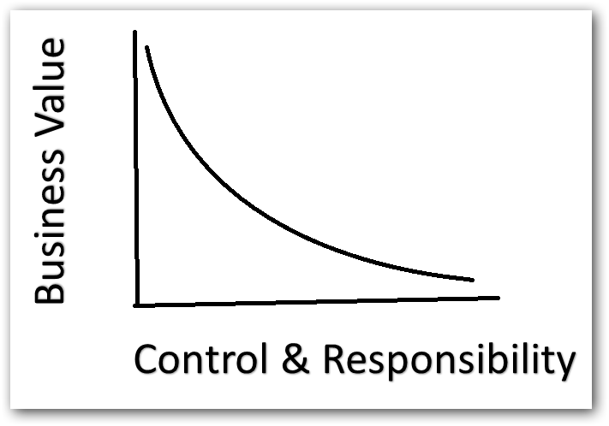
Control & Responsibility over Business Value
Simple analogy -
Build a car (or)
Buy a car (or)
Rent a car ?
Flexibility of cloud resulted in the availability of many SaaS form products like MongoDB Atlas, Microsoft Azure Notebooks / Colab…
Notes:
DevOps analogy - Fail quickly. Prove ROI. Then Scale yourself.
Apart from Software as a service, Atlas – Database as a service, Colab – Programming as a service.

Slide 20
Cloud
Allowed to be conservative in investments.
Crawl before you walk and walk before you run.
Elasticity both for Storage and Processing.
Notes:
THE CLOUD IS BREAKING DOWN BARRIERS

Slide 21
Services from the initial stages (2012) till now
Storage – HDFS –>Azure Data Lake...
Processing – Map Reduce –> Azure Kubernetes cluster, –> Azure Synapse Analytics, –> Azure Databricks...
Resources elasticity -> Create as you go via Automation scripts in PowerShell, Ansible.
Streaming Analytics –> Apache Flink, Kafka Streams –> Azure Stream Analytics.
Notes:
Listed with Azure for example - That too Azure Synapse Analytics take care of resource computation by itself “server as service”.

Slide 22
Streaming Platform necessity
https://aws.amazon.com/streaming-data/
Notes:
Streaming data – Generated continuously by thousands of data sources mostly of small size(kb) data. The third V in Big Data.
Streaming platform is nothing but the system that handles such a process.

Slide 23
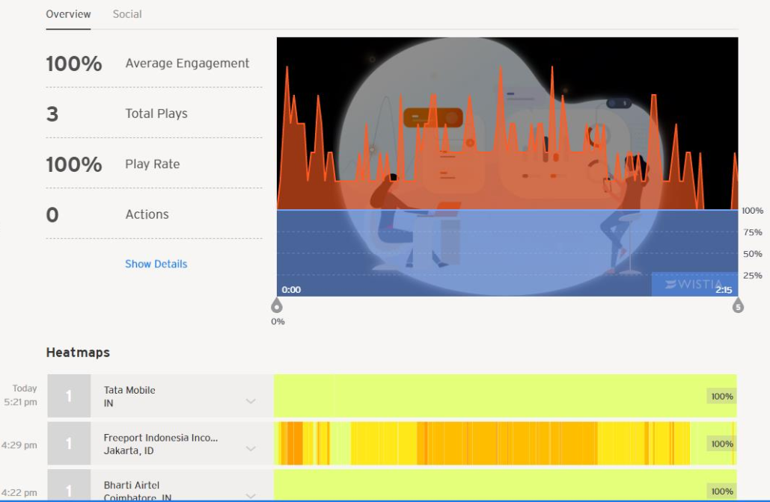
Streaming Use cases
Sensors in transportation.
Stock market.
Geospatial data oriented apps like Cab booking.
Energy sectors like Solar power machines.
Large Machines.
Clickstream (Not just website; Videos. E.g. Wistia)
Online gaming – PUBG.
Notes:
Different file formats.
Different reporting tools.
Different data types – Phone calls, Logs, Feedbacks.

Slide 24
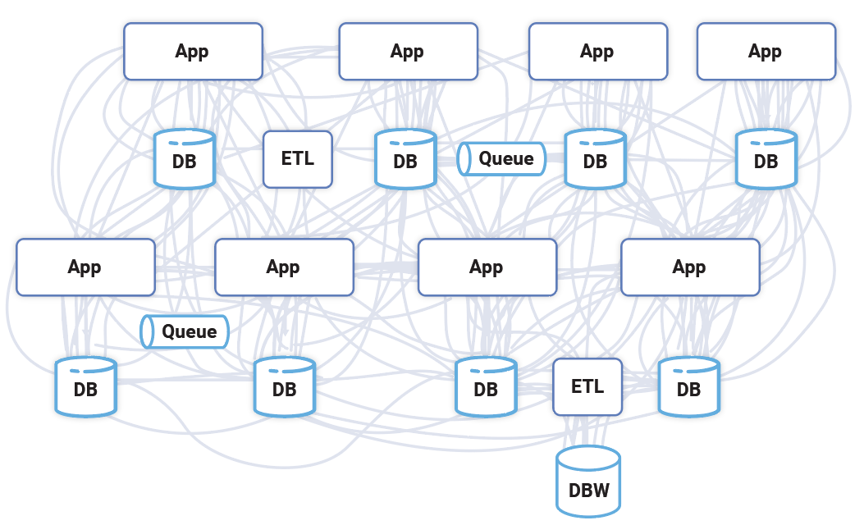
https://www.confluent.io/blog/every-company-is-becoming-software/
Notes:
Integration is a big hurdle—especially as data comes in from multiple sources, departments, and geographies.
I am going to tell 2 solutions which large scale clients already started adopting.

Slide 25
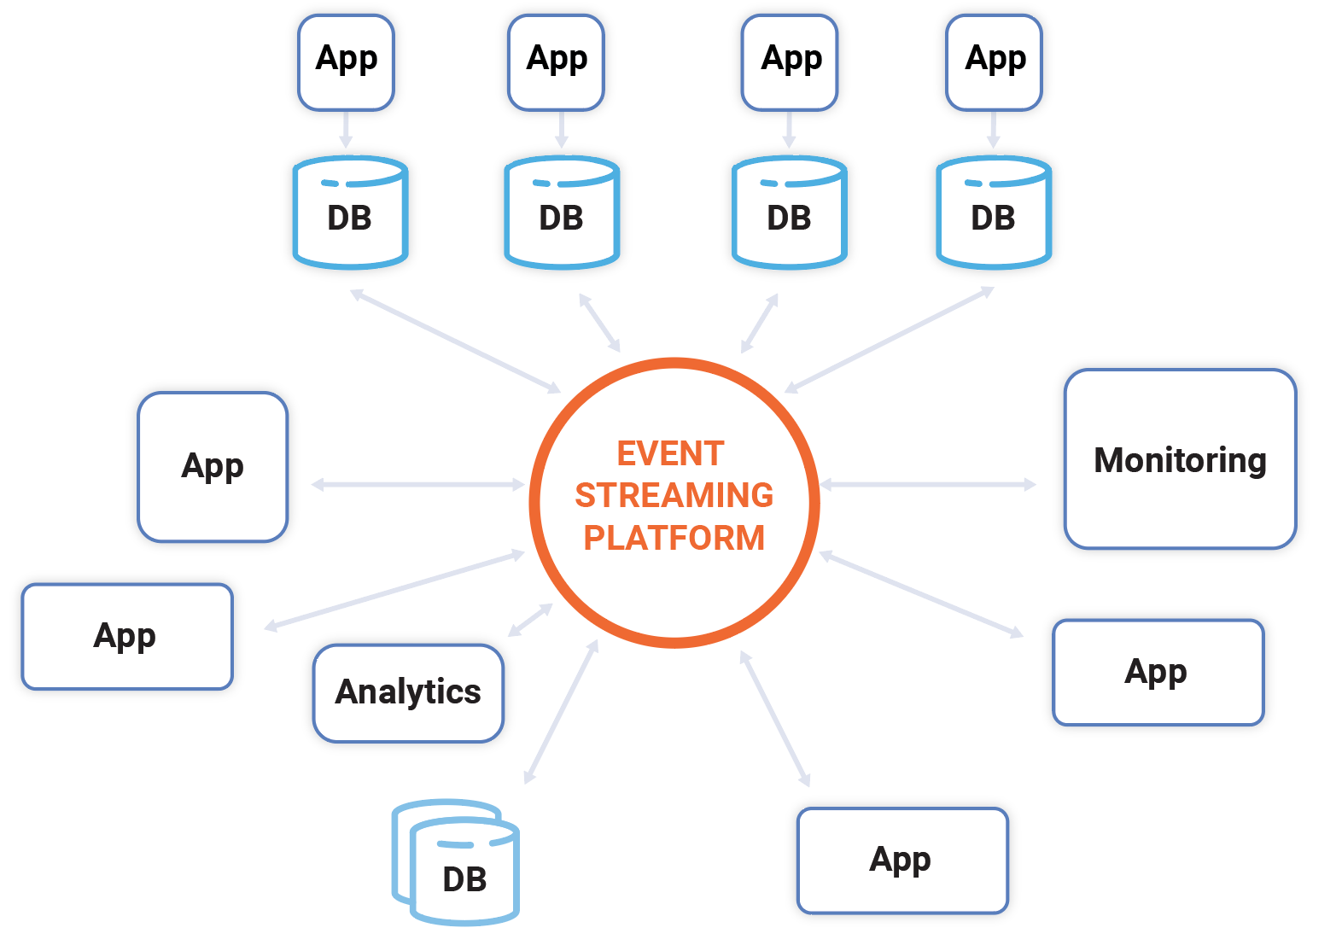
https://www.confluent.io/blog/every-company-is-becoming-software/
Notes:
- Each application publishes the stream related to its part of the business and relies on the other streams, in a fully decoupled manner.
- Central nervous system for all your data. E.g. A multi-cell living creature like us co-ordinated by a central nervous system.

Slide 26
Apache Kafka
- New world of Event-Driven streaming. Successful both as open source and commercial (Confluent).
Batch -> Real time. (Even some banks)
Notes:
First solution for integration. Kafka is built to be specialized for Event Streaming Platform.

Slide 27
Stream Analytics necessity
Notes:
Expectations are sky-high—for both using data to capture new insights and unlock efficiencies and business growth QUICKLY.
Stream processing will be handling simple response functions. Whereas Stream analytics I mean here will be of more aggregations and little bit more complex queries.

Slide 28
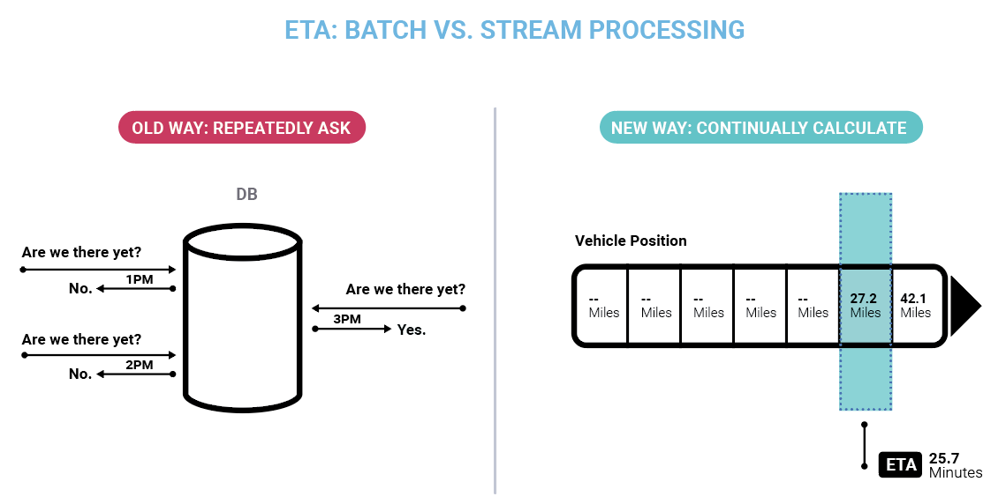
https://www.confluent.io/blog/every-company-is-becoming-software/
Notes:
We’re all familiar with the age-old question: “Are we there yet?” The traditional database is a bit like a child and has no way to answer this other than just asking over and over again. With stream processing, the ETA becomes a continuous calculation always in sync with the position of the car. i.e. Process the data within a rolling time window or just the most recent data record alone.

Slide 29
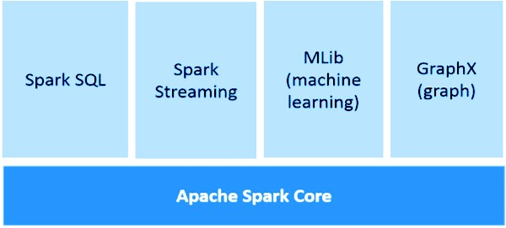
Spark Streaming Kafka Streams (KSQL)
Hadoop made fast. So decision-making as well.
Kafka Streams
Java application to process over streaming data right away.
KSQL – A wrapper on top of Kafka streams with which you can use SQL like language for processing.
Spark
In memory caching and adhoc queries.
Rich ecosystem:

Slide 30
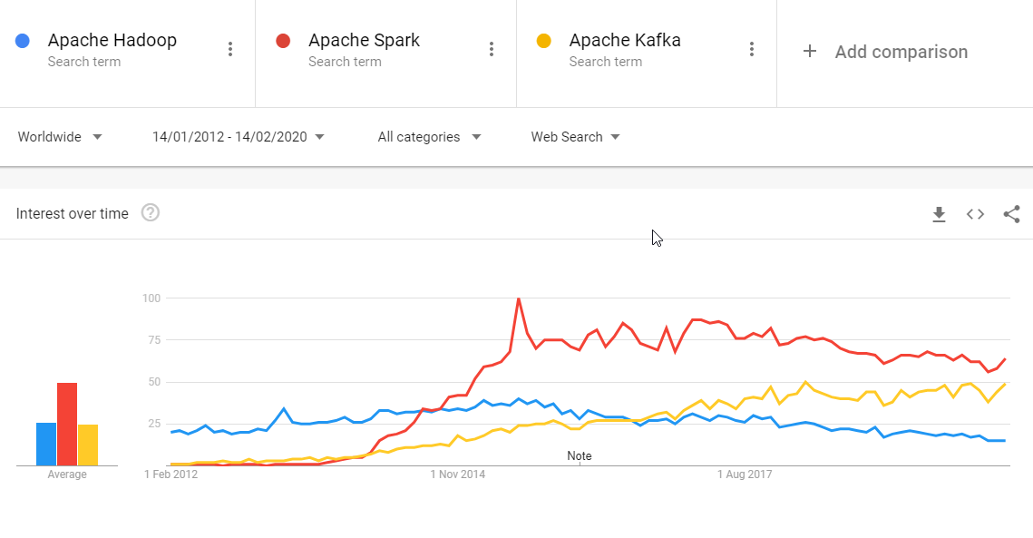
Notes:
https://trends.google.com/trends/explore?date=2012-01-14%202020-02-14&q=Apache%20Hadoop,Apache%20Spark,Apache%20Kafka

Slide 31
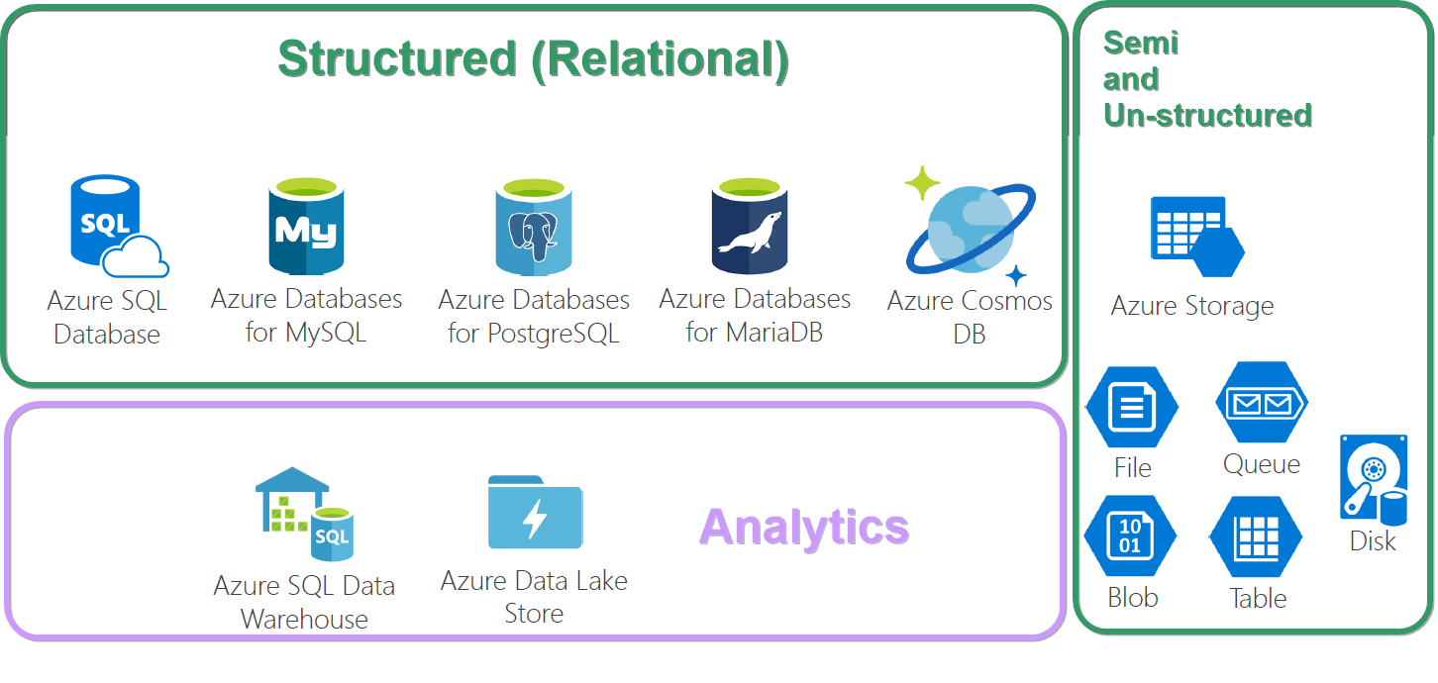
Storage options in Azure
Notes:
Database and Data warehouse - Both are relational, but serve 2 different purposes.
Database - Mostly if CRUD alone is done. Single source. OLTP for ACID. Mostly current.
Data warehouse - If complex schema with hundreds of table. Complex SQL queries for summarizing. Consolidated from different data sources. OLAP. Mostly historical
https://panoply.io/data-warehouse-guide/data-warehouse-architecture-traditional-vs-cloud/
https://panoply.io/data-warehouse-guide/the-difference-between-a-database-and-a-data-warehouse/

Slide 32
Cloud Data warehouses
Hadoop, Spark, etc. – Need specialized skills to build and maintain.
Reduces project development time for machine learning, BI, and AI.
Amazon Redshift | Google Big Query | Snowflake | Azure SQL Warehouse
Better than others – MPP | Analytics workloads | Less admin needed, better support. | Performs better and looks cheaper for large scale of data (1 TB or more)
S3 - direct integration |  | Multi-cloud deployment options. | Glues with storage layer and Power BI better.
https://www.itcentralstation.com/categories/cloud-data-warehouse
https://fivetran.com/blog/warehouse-benchmark
Notes:
Summarized points from some benchmark sites and some folks worked around the same.
On the whole the selection of data warehouse depends mostly based on cloud provider that the company uses for most of the cases.

Slide 33
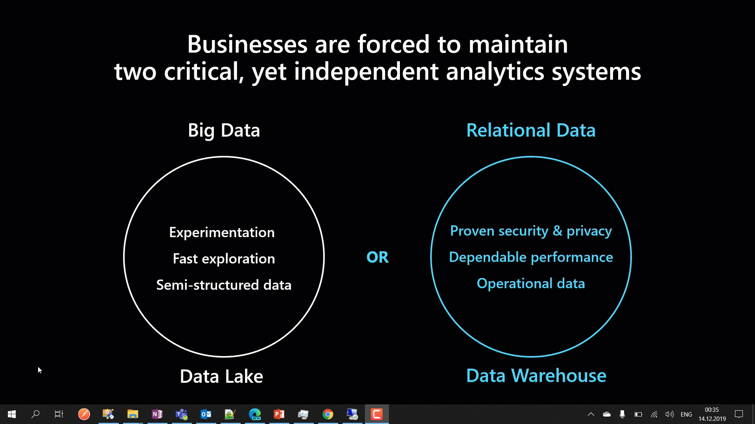
Notes:
A business will have both these storage systems.
https://www.educba.com/big-data-vs-data-warehouse/

Slide 34
Azure Synapse Analytics
Simplifies your data lake and data warehousing solutions – Datalakehouse.
Reduces project development time for machine learning, BI, and AI.
Notes:
2nd solution for integrating data sources together.
Synapse Analytics combines Big Data and Relational Data to combine as one.
Spark, Azure ML integration made so easy.
T-SQL queries over semi-structured data stored in Data Lake as well.
And yes. All these are possible with other data warehouse solutions also. But the integration should be done by us, where Synapse has it done on its own.

Slide 35
SQL Server Big Data Clusters

Slide 36
ML.Net
Open source cross-platform machine learning framework.
Custom ML made like a play with AutoML – GUI.
Not required much expertise in ML.
https://dotnet.microsoft.com/learn/ml-dotnet/get-started-tutorial/intro

Slide 37
How does Big Data (engineer) work?
2. Identify source(s) of Data
4. Storage & Access
5. Processing
6. Visualization
3. Data Integration
1. Defining Objective
Notes:
With many new tools

Slide 38

Use case
An insurance firm.
Grown over the years through acquisition of many small insurance companies - hence, it doesn’t have a single, consolidated view of their customer base.
Also details are fragmented among many subsystems, product lines -
Health insurance,
Vehicle insurance,
Pet insurance, etc.
So plans to build a data lake.
Data scientists or BI analysts to generate insights.
From: https://www.thoughtworks.com/insights/blog/curse-data-lake-monster
Notes:
Different file formats.
Different reporting tools.
Different data types – Phone calls, Logs, Feedbacks.

Slide 39

1. Defining Objective
Understand the domain & industry,
Discuss about the business need / problem,
Ask more and more WHYs?
Prepare the objectives.

Slide 40
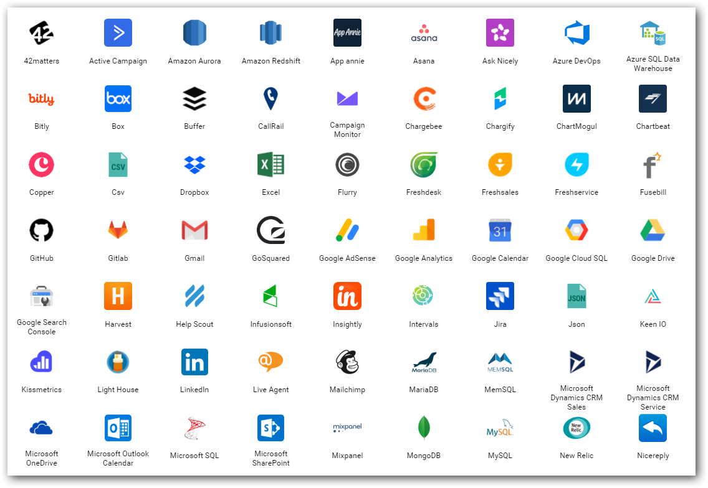
2. Data source(s)
Find out from where you need to get the data for your project.
Either provided or should search and find.
Logs
DB / DW
Web (REST APIs)
Social Media
…
Notes:
Logs – NASA logs which we gonna process.

Slide 41
3. Data Integration
Required data would exist in different sources those need to be brought to one place for,
Gather
Clean
Prepare
Tools
Apache Sqoop
Azure Data Factory
Informatica
Apache Nifi
Apache Kafka, Rabbit MQ, Azure Event Grid, Service Bus,..

Slide 42
4. Storage & Access
Different stages
Initial
Processing
Final
Instances & Services
Cloud Database instances (SQL Server, MySQL,..)
Azure Data Lake…
Access with Security on top
Extra measures to protect unstructured data
API easy to integration between processing tools

Slide 43
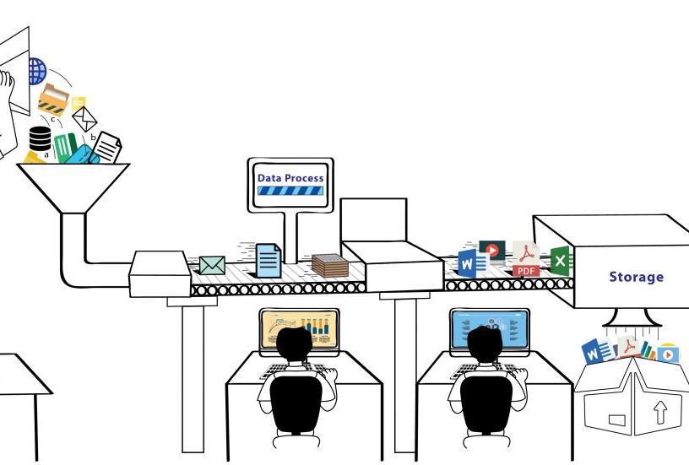
5. Process
Analyze / Do Analytics
ML models
Map Reduce
Tools & Services
Apache Pig
Azure HDInsight
Azure Databricks (Spark)
Azure ML Studio
ML .Net

Slide 44
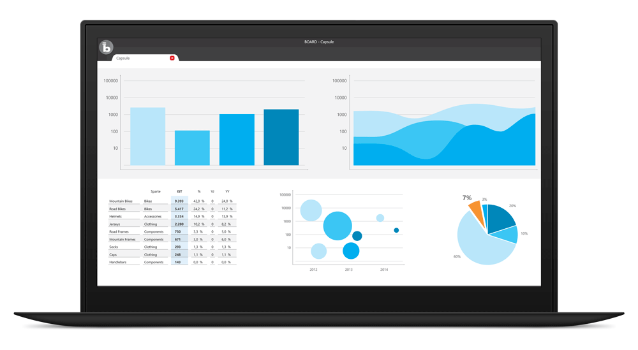
6. Visualize
BI tools for business decisions
Microsoft Power BI
Tableau
Qlik
Bold BI
…
In-built packages in R, Python

Slide 45
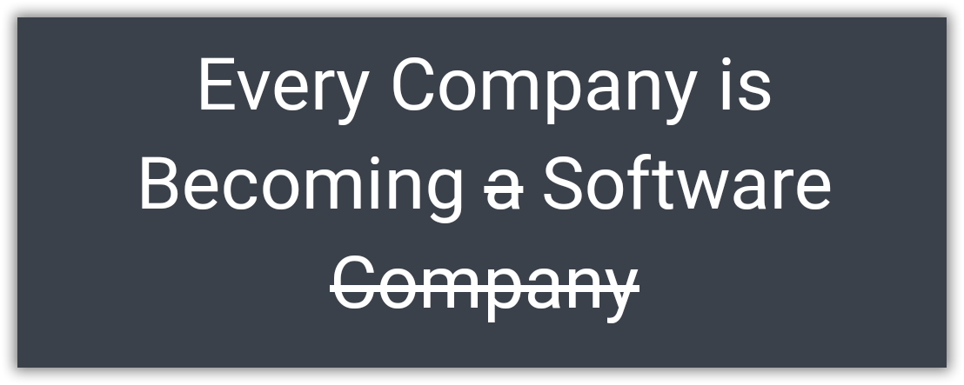
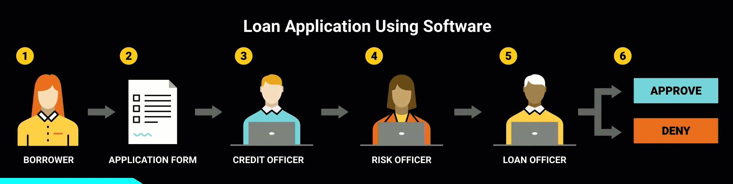
Borrowed from - https://www.youtube.com/watch?v=4QoCbhsQeyE
Notes:
Nowadays, a bank itself is software and takes the decision. Same case earlier humans took decisions using that software. A perfect example would be of sanctioning a personal loan. Things like the CIBIL score, a person’s authenticity available as up-to-date data has provided the power to decide to sanction a loan to machines themselves. Earlier, 1 or more bank employees should do the entire work of analyzing all these.
Finally I would like to end with this quote from Confluent.IO. “Every Company is Becoming software, which were previously just Using the software.”

Slide 46
Notes:
Again. Integration challenges, ranging from varied data formats and storage requirements to time-consuming, manual data exports and imports.ata project or any projects that ends with delivering something for decision making.
The challenges wont get reduced. But on the go, you will be more efficient in asking questions and deciding right set of tools.

Slide 47
Thank you! Q & A

